Slide 1
Lecture 6 Understanding the Human being as Co-existence of the Self and the Body

Slide 2
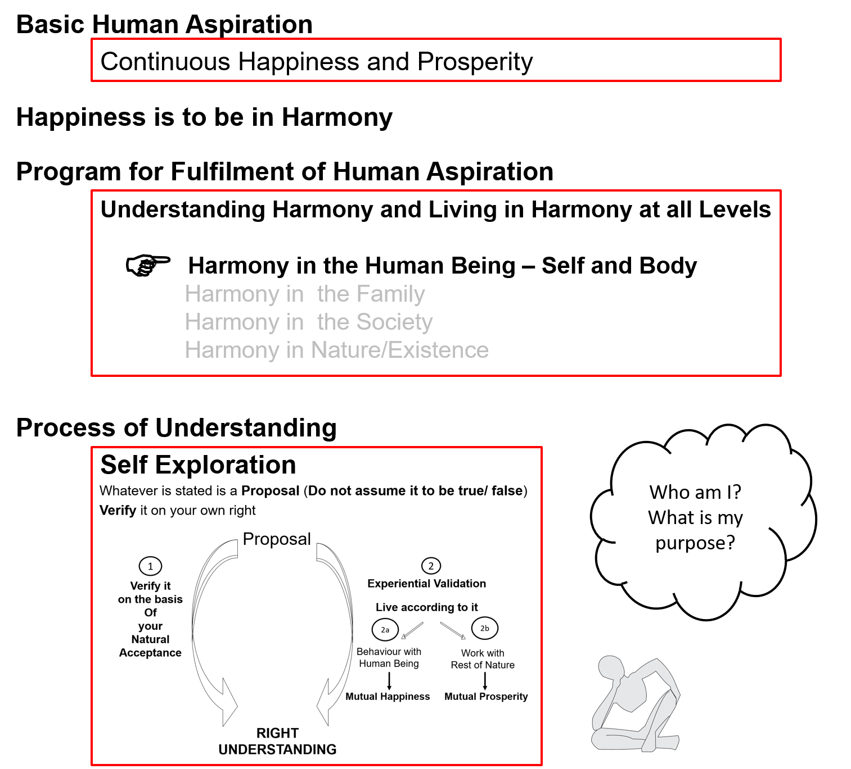

Slide 3
Human Being Ekkuo | Self eSa | Body “kjhj
Co-existence
lgvfLrRo

Slide 4
Human Being Ekkuo | Self eSa | Body “kjhj
Need vko';drk | Happiness (e.g. Respect) lq[k ¼tSls lEeku½ | Physical Facility (e.g. Food) lqfo/kk ¼tSls Hkkstu½
In Time dky esa | Continuous fujUrj | Temporary lkef;d
In Quantity ek=k esa | Qualitative (is Feeling) xq.kkRed ¼Hkko gS½ | Quantitative (Required in Limited Quantity) Ekk=kRed ¼lhfer ek=k esa½
Co-existence
lgvfLrRo
Are these needs are of different types or of same type?
Are both types of needs important / Do we want fulfillment of both types of needs?
Are we working to fulfill both types of needs?
What is the priority between the needs of the Self & the needs of the Body?

Slide 5
Human Being Ekkuo | Self eSa | Body “kjhj
Need vko';drk | Happiness (e.g. Respect) lq[k ¼tSls lEeku½ | Physical Facility (e.g. Food) lqfo/kk ¼tSls Hkkstu½
In Time dky esa | Continuous fujUrj | Temporary lkef;d
In Quantity ek=k esa | Qualitative (is Feeling) xq.kkRed ¼Hkko gS½ | Quantitative (Required in Limited Quantity) Ekk=kRed ¼lhfer ek=k esa½
Fulfilled By iwfrZ ds fy, | Right Understanding & Right Feeling lgh le>] lgh Hkko | Physio-chemical Things HkkSfrd&jklk;fud oLrq
Co-existence
lgvfLrRo
The needs of the Body can not be fulfilled by Right Understanding, Right Feelings alone
The needs of the Self can not be fulfilled by Physio-Chemical Things
Both type of needs have to be understood separately
Both type of needs have to be fulfilled separately
In living, what is the priority?
How much time & effort is spent for right understanding & right feelings?
How much time & effort is spent for physical facility?

Slide 6
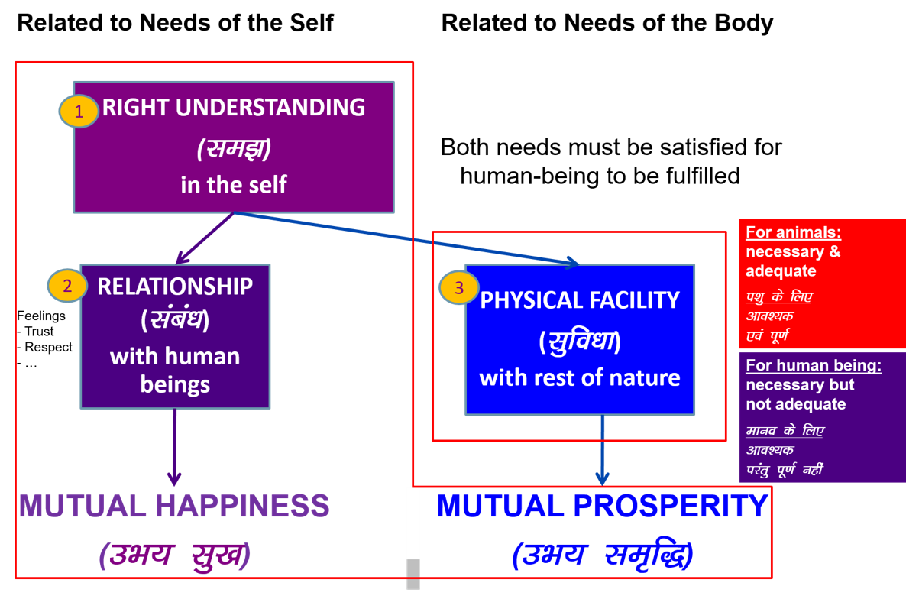

Slide 7
Human Being Ekkuo | Self eSa | Body “kjhj
Need vko';drk | Happiness (e.g. Respect) lq[k ¼tSls lEeku½ | Physical Facility (e.g. Food) lqfo/kk ¼tSls Hkkstu½
In Time dky esa | Continuous fujUrj | Temporary lkef;d
In Quantity ek=k esa | Qualitative (is Feeling) xq.kkRed ¼Hkko gS½ | Quantitative (Required in Limited Quantity) Ekk=kRed ¼lhfer ek=k esa½
Fulfilled By iwfrZ ds fy, | Right Understanding & Right Feeling lgh le>] lgh Hkko | Physio-chemical Things HkkSfrd&jklk;fud oLrq
Activity fØ;k | Desire, Thought, Expectation… bPNk] fopkj] vk”kk--- | Eating, Walking… [kkuk] pyuk---
In Time dky esa | Continuous fujUrj | Temporary lkef;d
Co-existence
lgvfLrRo

Slide 8
Human Being Ekkuo | Self eSa | Body “kjhj
Need vko';drk | Happiness (e.g. Respect) lq[k ¼tSls lEeku½ | Physical Facility (e.g. Food) lqfo/kk ¼tSls Hkkstu½
In Time dky esa | Continuous fujUrj | Temporary lkef;d
In Quantity ek=k esa | Qualitative (is Feeling) xq.kkRed ¼Hkko gS½ | Quantitative (Required in Limited Quantity) Ekk=kRed ¼lhfer ek=k esa½
Fulfilled By iwfrZ ds fy, | Right Understanding & Right Feeling lgh le>] lgh Hkko | Physio-chemical Things HkkSfrd&jklk;fud oLrq
Activity fØ;k | Desire, Thought, Expectation… bPNk] fopkj] vk”kk--- | Eating, Walking… [kkuk] pyuk---
In Time dky esa | Continuous fujUrj | Temporary lkef;d
Response | Knowing, Assuming*, Recognising, Fulfilling tkuuk] ekuuk] igpkuuk] fuokZg djuk | Recognising, Fulfilling igpkuuk] fuokZg djuk
Co-existence
lgvfLrRo
* Assuming or Accepting

Slide 9
Knowing & Assuming (Accepting)
Knowing, Assuming, Recognizing, Fulfilling
Problem leL;k
Education-Sanskar
Resolution
lek/kku
Preconditioning or
Assuming without Knowing
Assumptions keep changing
Conduct is indefinite (Dependence, Partantrata)
Knowing through self-verification
– on the basis of Natural Acceptance & – on the basis of living accordingly
Assumptions are definite (on the basis of Knowing)
Conduct is definite (Swatantrata)
KNOWING To see the reality as it is, in its completeness, by direct observation
It is definite, has continuity & universality
ASSUMING Acceptance of the reality
(acceptance can be on the basis of knowing or even without knowing)
RECOGNISING The relationship (with human being and with rest of nature)
FULFILLING The relationship (with human being and with rest of nature)

Slide 10
Human Being Ekkuo | Self eSa | Body “kjhj
Need vko';drk | Happiness (e.g. Respect) lq[k ¼tSls lEeku½ | Physical Facility (e.g. Food) lqfo/kk ¼tSls Hkkstu½
In Time dky esa | Continuous fujUrj | Temporary lkef;d
In Quantity ek=k esa | Qualitative (is Feeling) xq.kkRed ¼Hkko gS½ | Quantitative (Required in Limited Quantity) Ekk=kRed ¼lhfer ek=k esa½
Fulfilled By iwfrZ ds fy, | Right Understanding & Right Feeling lgh le>] lgh Hkko | Physio-chemical Things HkkSfrd&jklk;fud oLrq
Activity fØ;k | Desire, Thought, Expectation… bPNk] fopkj] vk”kk--- | Eating, Walking… [kkuk] pyuk---
In Time dky esa | Continuous fujUrj | Temporary lkef;d
Response | Knowing, Assuming, Recognising, Fulfilling tkuuk] ekuuk] igpkuuk] fuokZg djuk | Recognising, Fulfilling igpkuuk] fuokZg djuk
Co-existence
lgvfLrRo

Slide 11
Human Being Ekkuo | Self eSa | Body “kjhj
Need vko';drk | Happiness (e.g. Respect) lq[k ¼tSls lEeku½ | Physical Facility (e.g. Food) lqfo/kk ¼tSls Hkkstu½
In Time dky esa | Continuous fujUrj | Temporary lkef;d
In Quantity ek=k esa | Qualitative (is Feeling) xq.kkRed ¼Hkko gS½ | Quantitative (Required in Limited Quantity) Ekk=kRed ¼lhfer ek=k esa½
Fulfilled By iwfrZ ds fy, | Right Understanding & Right Feeling lgh le>] lgh Hkko | Physio-chemical Things HkkSfrd&jklk;fud oLrq
Activity fØ;k | Desire, Thought, Expectation… bPNk] fopkj] vk”kk--- | Eating, Walking… [kkuk] pyuk---
In Time dky esa | Continuous fujUrj | Temporary lkef;d
Response | Knowing, Assuming, Recognising, Fulfilling tkuuk] ekuuk] igpkuuk] fuokZg djuk | Recognising, Fulfilling igpkuuk] fuokZg djuk
 | Consciousness pSrU; | Material tM+
Co-existence
lgvfLrRo

Slide 12
the
Human Being Ekkuo | Self eSa | Body “kjhj
Need vko';drk | Happiness (e.g. Respect) lq[k ¼tSls lEeku½ | Physical Facility (e.g. Food) lqfo/kk ¼tSls Hkkstu½
In Time dky esa | Continuous fujUrj | Temporary lkef;d
In Quantity ek=k esa | Qualitative (is Feeling) xq.kkRed ¼Hkko gS½ | Quantitative (Required in Limited Quantity) Ekk=kRed ¼lhfer ek=k esa½
Fulfilled By iwfrZ ds fy, | Right Understanding & Right Feeling lgh le>] lgh Hkko | Physio-chemical Things HkkSfrd&jklk;fud oLrq
Co-existence
lgvfLrRo
Consciousness
Need of the Self = Continuous happiness = Need of consciousness
Fulfilled by = Right Understanding and Right Feeling in the Self = Activities of consciousness
(The need of consciousness is fulfilled by activities of consciousness)
Notes:
Fulfilled by
Flower to Father – flower is only a symbol. Feeling is primary. Feelings ka bandh mein band kar rakha hai – feelings ka aadan-pradan nahin hota. Feelings ka exchange bhi sukhi hone ka tareeka hai, yeh dhyan mein nahin aaya rahta
One cant fulfill the other
Exclusive dress – attention neq respect. Dress se attention bhar mil paata hai

Slide 13
the
Human Being Ekkuo | Self eSa | Body “kjhj
Need vko';drk | Happiness (e.g. Respect) lq[k ¼tSls lEeku½ | Physical Facility (e.g. Food) lqfo/kk ¼tSls Hkkstu½
In Time dky esa | Continuous fujUrj | Temporary lkef;d
In Quantity ek=k esa | Qualitative (is Feeling) xq.kkRed ¼Hkko gS½ | Quantitative (Required in Limited Quantity) Ekk=kRed ¼lhfer ek=k esa½
Fulfilled By iwfrZ ds fy, | Right Understanding & Right Feeling lgh le>] lgh Hkko | Physio-chemical Things HkkSfrd&jklk;fud oLrq
Co-existence
lgvfLrRo
Material
Need of the body = Physical facility* = Material in nature
Fulfilled by = Physio-chemical things = also material in nature
(The need of material is fulfilled by material)
*physical facility is required for nurturing, protection and right utilization of the body
Notes:
Fulfilled by
Flower to Father – flower is only a symbol. Feeling is primary. Feelings ka bandh mein band kar rakha hai – feelings ka aadan-pradan nahin hota. Feelings ka exchange bhi sukhi hone ka tareeka hai, yeh dhyan mein nahin aaya rahta
One cant fulfill the other
Exclusive dress – attention neq respect. Dress se attention bhar mil paata hai

Slide 14
Sum Up
Human being is a co-existence of Self and Body
Self is consciousness. Its needs are feelings in consciousness (like happiness) and these needs are fulfilled by activity of consciousness, i.e. Right Understanding & Right Feeling
Body is material. Its needs are material (like food) and these needs are fulfilled by material, i.e. Physio chemical things
The needs of consciousness can not be fulfilled by material
The needs of material can not be fulfilled by consciousness alone
The recognition & fulfillment of the body is definite
The recognition & fulfillment in the self is on the basis of knowing, assuming
If the assumption is based on knowing, the assumption is right and the recognition & fulfillment is correct 🡪 definite conduct
If the assumption is without knowing, the assumption may or may not be right , so the recognition & fulfillment is uncertain 🡪 indefinite conduct

Slide 15
Self Reflection

Slide 16
Self Reflection
Is human being
just the body or
co-existence of self and body or
something else
Are you able to see distinctly & separately
The need of the self & the need of the body
The fulfillment of the need of the self & need of the body
The activity of the self & the activity of the body
The response of the self and the response of the body
Are you going by assuming or by knowing? Whether your recognition & fulfillment is based on:
assuming without knowing or
assuming based on knowing

Slide 17
FAQ

Slide 18
FAQ
Some of the activities of the body are also continuous, like breathing, like blood flowing through the blood vessels. Right?
How can we be sure that thoughts are going on all the time? Like when we are sleeping, we are not thinking… I suppose
I can see the body because it is tangible, but the self is intangible. So how can we see the self?
What happens to the self after the body dies? Does it also die with the body?
Once you know, why would you still need to assume? Please explain what exactly is the meaning of knowing and what is the meaning of assuming
Is the self same as mind?

Slide 19
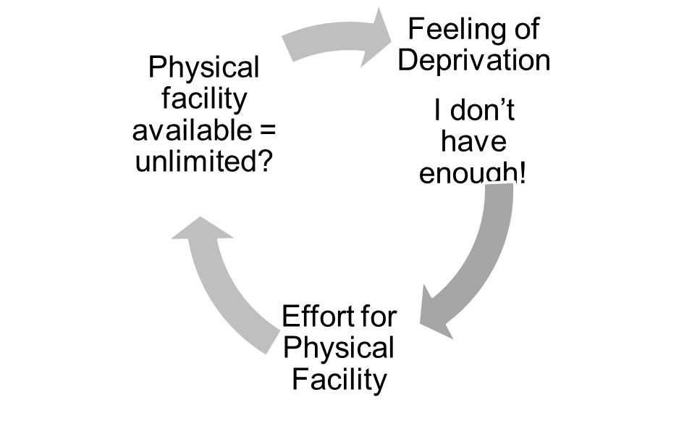
Evaluation of Current Situation - Gross Misunderstanding
Assumption: Human being = Body
Needs of human being = physical facility
and feelings
Need for feelings (like respect) is continuous
All needs are fulfilled by physical facility
(Eg. clothes, house, car… will fetch respect)
Physical facility required = unlimited!

Slide 20
Some Implications of a wrong assumption
If the assumption is Human Being = Body
Then happiness is sought through
sensation (through the body) or
getting the right feeling from the other
As a result
The body is harmed due to excessive consumption or over indulgence to get favourable sensation
Continuity of happiness can not be ensured
There is a major impact on family, society, nature…
e.g.
Over eating, consumption of "junk food" etc. is common
A large number of diseases are psychosomatic in nature
Today many of the complaints are related to the lack of feeling

Slide 21
Implications on Health Education & Health Services
1. Understanding the importance of the self in keeping the body healthy. Health care professionals will be able to take care of both the health of the body as well as understanding in the self
A large number of diseases are psychosomatic in nature
Many disorders are related to lack of understanding of a healthy lifestyle
2.Understanding the importance of the self and the feeling related to the self, caregivers will be able to take into account the feelings while providing care
Today many of the complaints are related to the lack of feeling
The major issue of exploitation for profit will be handled
3. One would be able to make right utilisation of physical facility
If happiness is sought through sensation alone
– continuity of happiness can not be ensured
– the body is harmed due to excessive consumption or over indulgence to get favourable sensation
Today over eating, consumption of "junk food" etc. is common

Slide 22
FAQ: Is Self = Ego?
Ans: When you do not understand the self, you sometimes over-evaluate the self and at other times under-evaluate the self
This over-evaluation of the self is Ego
Under-evaluation of the self is Depression
Both are caused by lack of understanding the self

